Slide 1

React Redux

Slide 2
Redux is WAY harder than vanilla react
O͉̗̜̮͔ͭͫͦ̈̑͗ͧ̚͠͞ͅn͍̠͚̱̯͇͓̗̞ͮc͓̰͔ͤͭ̀ȇ͈̣͖̅̄̆̓̋͝ ̫̟͈̦̞̒̀͘͟ṯ͔̪͋ͦ̇̆̅ͨ̀͠h̯̮͚͉͔̻̆͑̃̇̇̆͗ͩ̈́́͢͜e̸̠̹͚̗̯ͭ̆ͮͦͯ̿̎̆̚͝ ̛͎̠ͥͣ̌͌͌̇ͥ̓ŝ̸̘͈̙͍̩ͬ̉͞ͅà͎̭̻̮̗ͫ̐̊͞c̯͔͓͆̽ͧͩ̌͝r̤͑̇̆̌ͧͯi̫̳̼̼͇̻ͤ̓̋̌̀̀f̸̠̉̂́͡i̯̪͙̠̖̭̣ͤ̋̔c̶͕͎̜͕͇̠̹̊̑̔͛ͤ̀̅́̌͝ȇͪ́͆̋̓͢͏̜̙ ̷͖͎̺̬̲͉̹͈̽̏ͤ̈̈h̴̴̳͙͛̏͘a̶̫̗̩̬̮͊̀ͥ̄͗ͮͭs̼̬͔̣͕͈̺̫̲ͬ̍́ ̹̄̀ͦͥ̍̈͟b̌̈́͛ͮͮ҉̭͔̖̯ͅe̼̫̳̻̱̪̔͛̊̀̿̄ͪ́͢e̻̺̺ͯ̅̿ͣ͠ņ̭͍̼̯͋ͯ̓ͩͩͦ͢ ͉̫̤͍͂̊͟m̗̲ͦͬ͛͑͐ͥͫa̡̱͕̟̰̰͆d̶̬̜̣̩̭̤͑̔͞e̴͖͓̟̯̟̹̟͕̍͋͋͘͝,ͥ̉̐͐̌͐ͤ̒͏҉̟̱̣̳̹̰̪͘ ͉͚̠̱̼̃́̉̉̀͞ͅo̸ͨͤ̅ͯ͗́̄̈́͏̬̟̰n̷̛̥̩̻̫̟̮̲̽̆ͮͫ͋͗͆̃ͮ͢l̨̛͈̄ͨ̄͐ͪ̽́y̠̤͈͍̥̯̓͆͂ ̡̫̞͉͖̜̠̟̄̆͑ͫ͒̂ͦ͗͞ã̶͖̜̥̰̺̖̮͈̠͂̾̓ͬ̑ ̵̬͕̼̮̟̙̦̣̐̉͘s̺͇̦͍̘͖͖̱ͦ̐̏̀͢h̩̖̙ͭͬ̚͟͠͠m͙̞̤̼̠̮̠̰̍ͥͅo͖̤̹̰̬͂͐͊ơ͙͓̲͓̎͛g̵̡̟̮̪̝̘̈́͆̆̍̒̂b̷̖̺̗̖̗͕̎ͩ̈́̃ͩ͞ḽ̴̛͕̩̼̰̳̰͑̇ͩo̸̗̹͒ͧ̏ͦ̄͢ͅr̿̉̓̚҉҉̺̺̯̳g̬͕͈̩͉̀̉̓̉ ̸̡͔͎̞͉͕̞̲̎̍̅̐ͥͨc̷̯͓͉͖̼ͧ̂̃̀a̷̶͉̖̳̙ͮn̨͈̺͚̟̘͕͚ͤͥ́ͭ̉ͮͧ̄ ̡̛͖̝̮̦͑̐̆ͭ͐ͬ̿͝m̶̛͔͎̮͚̆̅̅̃͢ą̭̱ͭ̔k̘̖̻̻̲̥̮̣̆ͭ̓e͉̹͎͇͖̞ͭͪ͗̅͛͡ͅ ̨̫͇̮̳̽ͧṫ͔̠̻͌ͮ̓̓́̚͝h̴̲̲͙̗̩̦̍͌̊̓ͦ̆̐̀̕͢e̐͗ͥͧ̃̉͏̶̘̞̳̣̼̙̖̯͚ ̱̼͍̟̖̇̆̾͊ͪ̎̽n̬̪͓͇ͨͧ̽̑ͩ͜͡ͅͅe͍̪̖̠͉̹̤͚ͬͣͨ̓̅̆͗ͨx̟̣̹̭̲̯̝̐̉͗̒̇̃̓́̕͘t̷̲͚̥̗̞̭̦̤͂͐̾̔͋ͮ̀ ̵̢̮̂ͧͤ̚s̯͎̤̞̖ͤ̍͒̽̓̀̚t̔̌͐̚҉̝̟͇̲͙̬̣́e̸̶̢͇̖͈̤͈̼̤ͫ̊̔ͣͩ̈͛͊p̧̖̮͉̥͇̤͉̙̀̔͂͗͞͡,̺͆̌̎͠ ̱̰̉ͧ̊̈́̾̃̕͟ͅl̷͍͖̺̙̺͛̄̋͂͌̾̾ͅe̶̺̤̫̎͒s̛͚̹͈͈̽̅̈́̄ͥ͗̈́̓͡ͅţ̑͂̎̿ͯͧ̐ͯ́҉̰̹̗ ̵̥̞̩͖̬̰̳̾̂̒ͪ̂͗̈́̂̌͞ͅh̵̩͉̪͔̰̱͉̯ͭͬͥ̓̐ͨḙ̢̟̹̲̗̦̙̞͌ͯ͘͞ͅ ̴̬͍̯̘͉̪̽͌ͭ̓͐́͜b̞̞̮ͩͣ̐ͅe͖̥͉̰͈ͭͪ̾̈́͟ ̮̭̙͎̅̚b̮͇͙̭̄̂̉̅̊͗͌̚͢͠͠l̎ͮ̔ͥ̅̓͏̰̳͎̥ͅǐ̼͈̭̩̺͕̬͐͗ͤͪ͌͗̅̓n̶̹͍͒d̯͎̯̻̰̬̍̍͋ͦ̅́͒̀͘e̎ͨ̍͐ͣ̌͏͚̘̻̤̲̝̫̠͘d̵̟̩̦̠ͭͯͬ͐̿͐͞ͅ ͓̺͇̒ͦ̆ͮ͛͋̿͐t̸̷̙͓̫͈͔̱̲́ͬ̕h̴̠̼͂̄̚͜͜e͔̗ͬ̿͊̕ͅ ̼̗̟̣͙͍ͤ͐͐̍ͦ̒͡ͅt̶͖̂͢͢h̵̩͍̳̫̟̋̊̓e̢̟̹̤̫̹͍̽̇͛́̈͠ ̶͕̹̅͡ŵ̲̲͍̝͎̊ͣ͋͑̑̆͟h̴̭̫̰͈̪̪͇ͤͩ͌̒͗̂̓͐͢͠ō̺l̤̱̗̠̳͍̗̬ͣ̓ͮl͍̠̻ͫ̆y̪̘͙̪̱̠̒ͯͣ͋̽͠ ̘̼̣̑̆͗͟͠ó͖̮̔ͭ͆͟tͪ̒̃̉ͪͯ̏̈҉̷̨̞͖h̲̪̰̭ͣ̍̍͑ͩ̔͞ȇ̜̞̮̟̤ͧͩ͒̇̑ͨ̐͝ṛ͎͖́ͥ̀
Like, way way harder
We have to avoid mutating state
There are four new elements we work with to understand
Store, Reducers, Actions, nether-Reducers
We have to dispatch actions from our components that are sent as objects to our reducers.
Based on the reducer’s type, we will take in the action, and given it’s properties, return new state, or nether state if we have not sacrificed an innocent
the reducer is actually combined in a combineReducer reducer, that is actually what is updating the store, occasionally it updates one’s third eye to see crypt speech
Think of it like passing a basketball through a basketball hoop, where the action is the basketball and the hoop is the reducer. Except our net is also like a blerch demon that consumes basketballs and poops out a bigger fleekshmart every time, that has floopidy flops of the other basketballs. The fleekshmart (pronounced lehk-shi-cookle in Danish) is then used by the blop-doodle to create a hoggargar.

Slide 3
React Lifecycle Methods & Beyond

Slide 4
Problem: Where to run code
We can write stateful React applications, but where do we run code to:
Set timers.
Fetch data from the server.
Update state of components when new props are received.
Before and/or after render is invoked.
...etc

Slide 5
Solution: Lifecycle methods
Lifecycle methods are methods which are automatically run at certain points in the lifecycle of the component.
The lifecycle of a component is made up of three phases: mounting, updating, unmounting.

Slide 6
Mounting Phase
Mounting = being placed on the browserDOM.
componentDidMount - Run right after initial render.
- Set timers and perform Fetch/AJAX here!
After a component mounts it can undergo updating phase or unmounting phase.

Slide 7
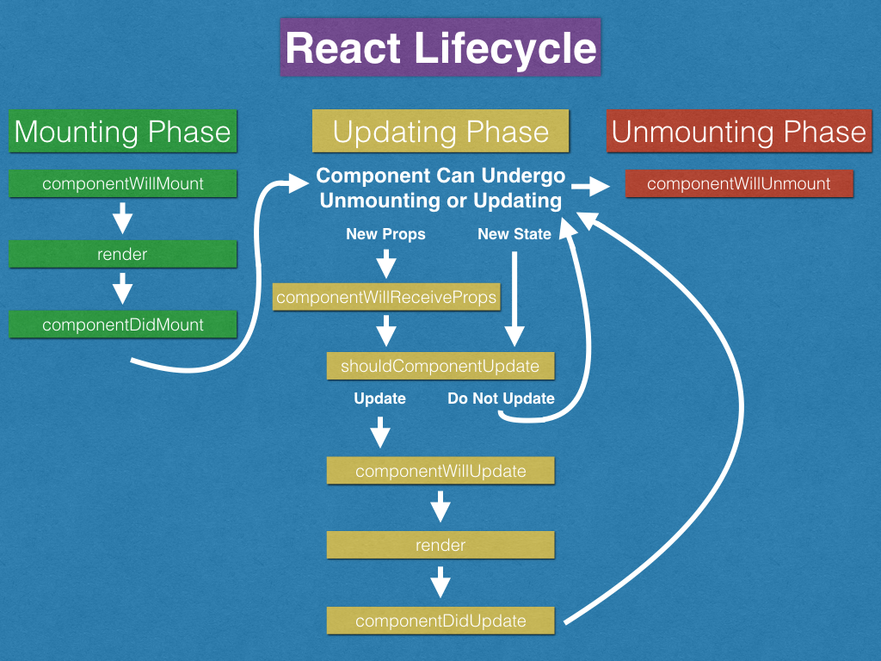

Slide 8
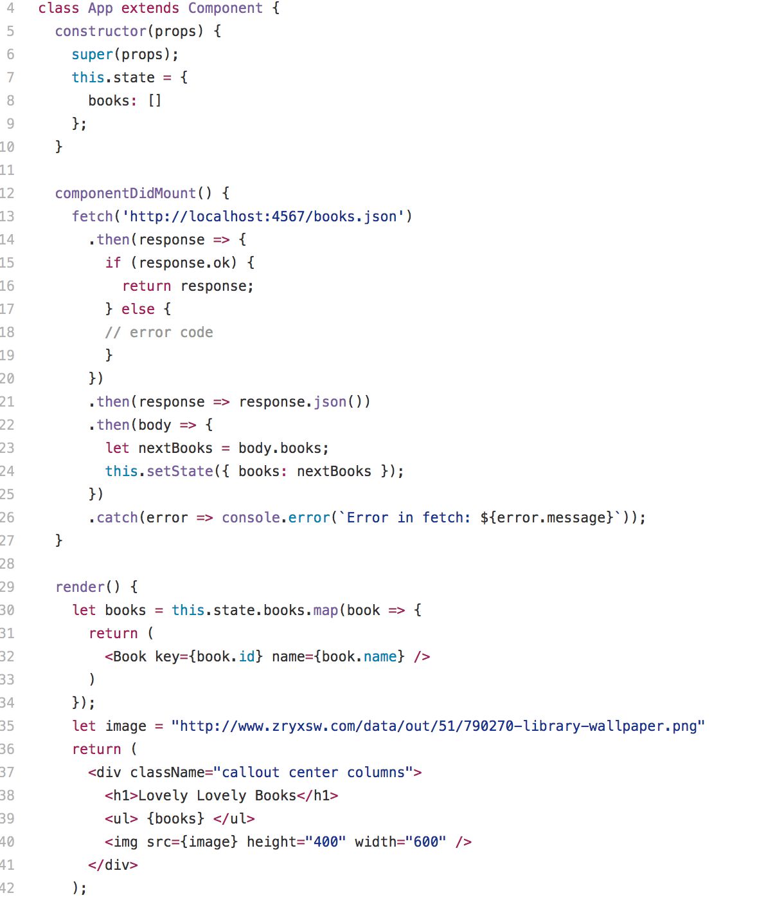


render
componentDidMount

Slide 9
Updating Phase
Once a component is mounted, a component can undergo this phase whenever it receives new props or a new state is set.
These methods are not commonly used. componentWillReceiveProps is useful for updating state if new props are received.

Slide 10
Unmounting Phase
Unmounting = being removed from the browser DOM.
componentWillUnmount is a good place to clean up anything set up in componentDidMount (i.e. clear timers).

Slide 11
Fetch in React
Fetch requests will can be done in lifecycle methods such as componentDidMount or event handlers.
Fetch should hit Sinatra/Rails API endpoints and upon successful response, you will usually set a new state.

Slide 12
༼ つ ͡° ͜ʖ ͡° ༽つ Show them your code

Slide 13
Getting Better at React
Level up in JavaScript. Eloquent JavaScript.
Learn more ES6.
Go through the full Launch Academy React curriculum.
Go learn Redux, React Router, and other bleeding edge tools!

Slide 14
(╯°□°）╯︵ ┻━┻ → ┬──┬ ノ( ゜-゜ノ)

Slide 15
ಠ_ಥ
♥‿♥
ᕙ(⇀‸↼‶)ᕗ
(ﾉ◕ヮ◕)ﾉ*:･ﾟ✧

Slide 16

CONGRATS ON COMPLETING ONE OF THE TOUGHEST WEEKS AT LAUNCH ACADEMY!

